Slide 1

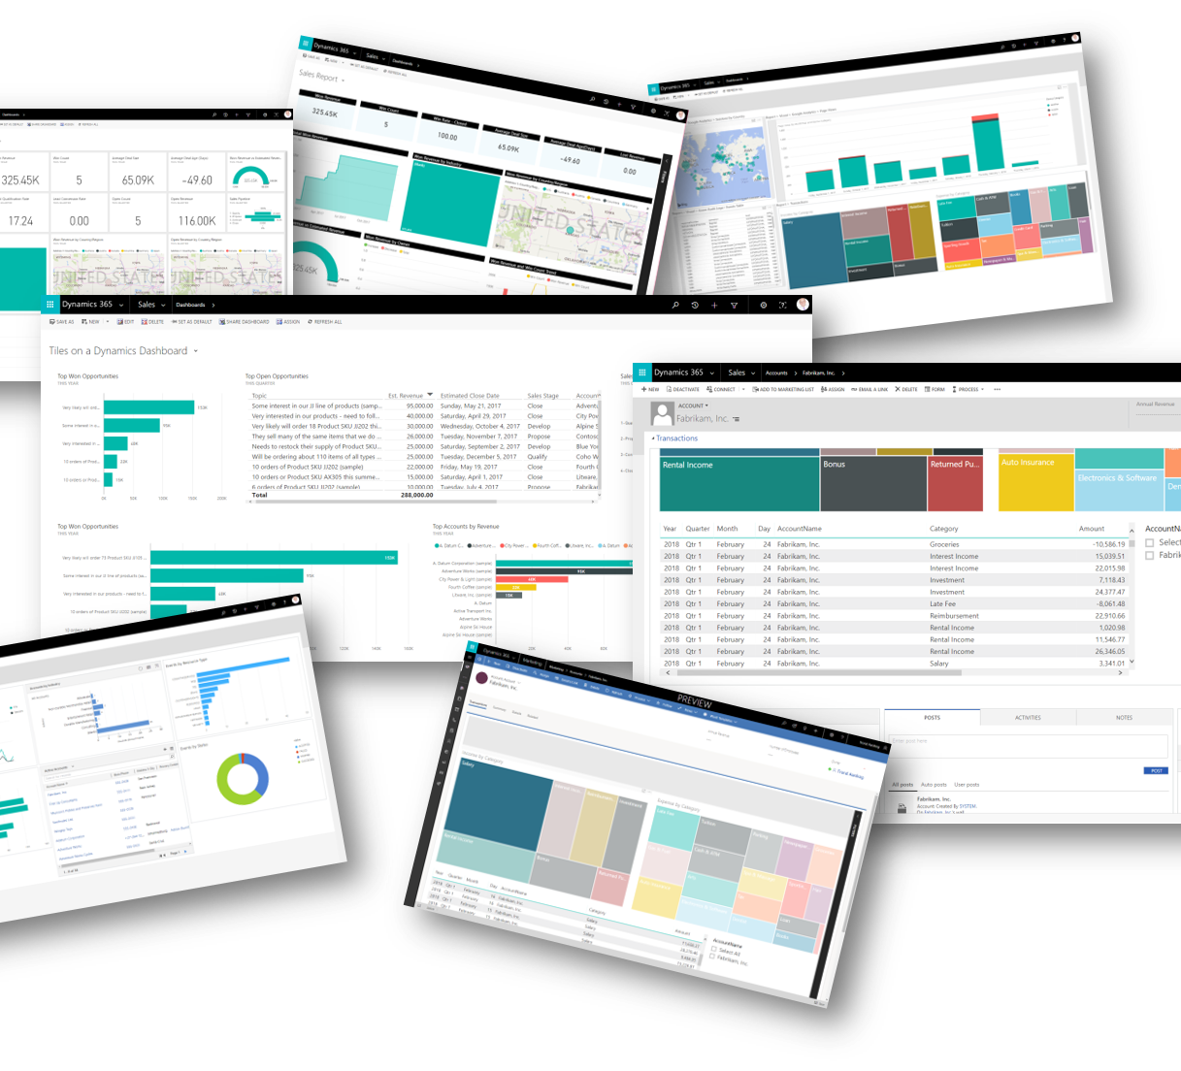
SUPERSTORE SALES DASHBOARD
Power Bi Project
Data Analysis By
Vanshika Sachdeva
This Photo by Unknown author is licensed under CC BY-SA.

Slide 2


OBJECTIVE
My mission is to boost business success by applying advanced data analysis techniques, with a specific focus on time series analysis. Through this, I aim to provide valuable insights and precise sales forecasting, contributing significantly to strategic decision-making and overall business growth.
This Photo by Unknown author is licensed under CC BY-SA-NC.

Slide 3

Description
Objective Breakdown into the following component's :
Dashboard Creation:
Identify key performance indicators (KPIs).
Design an intuitive and visually appealing dashboard.
Incorporate interactive visualizations and filtering capabilities for exploring data at different levels.
Data Analysis :
Provide valuable insights to business entities.
Utilize visualizations and charts to evaluate the effectiveness of sales strategies.
Sales Forecasting :
Leverage historical data.
Apply time series analysis to generate sales forecasts for the next 15 days.
Actionable Insights and Recommendations :
Extract insights to drive strategic decision-making.
Provide actionable information supporting the supermarket's goals for growth, efficiency, and customer satisfaction.
This Photo by Unknown author is licensed under CC BY-SA-NC.

Slide 4

Data Analysis
Sales by Segment:
The sales distribution across segments shows that the Consumer segment is the highest contributor (4%), followed by Corporate (3%) and Home Office (2%). This insight can guide marketing and sales strategies tailored to each segment's preferences and behaviors.
Sales by Region:
The East region dominates with 9% of total sales. This information could prompt further exploration into what factors contribute to the East region's success and whether similar strategies can be applied to other regions.
Sales by Payment Mode:
The payment mode breakdown indicates that Cash on Delivery (COD) has a significant share (5%). This might suggest a preference for this payment method among customers and could influence payment processing strategies.
Profit By Month:
The decreasing trend in profits over the past few months (12k, 10k, 8k, 6k) raises concerns. Further investigation is needed to identify the root causes, such as rising costs, declining sales, or other external factors impacting profitability.
This Photo by Unknown author is licensed under CC BY-NC.

Slide 5
Data Analysis
Sales by Month:
The information that monthly sales are consistently around 50k provides a baseline for understanding typical sales performance. Seasonal variations or deviations from this average could be explored to uncover trends or anomalies.
Sales by Ship Mode:
Knowing the popularity of different shipping modes (Standard Class, First Class, Second Class, Same Day) helps in optimizing logistics and delivery strategies. It provides insights into customer preferences for shipping speed.
Sales by Category and Subcategory:
Understanding sales by category (Office, Technology, Furniture) and subcategory (Phone, Chairs, Binders) helps identify product strengths and weaknesses. This information can guide inventory management and marketing efforts.
Superstore Sales Forecast - 15 Days:
The sales forecast for the next 15 days is a valuable tool for anticipating short-term trends and preparing for potential fluctuations in demand. It allows for proactive decision-making in inventory and resource allocation.
This Photo by Unknown author is licensed under CC BY-NC.

Slide 6
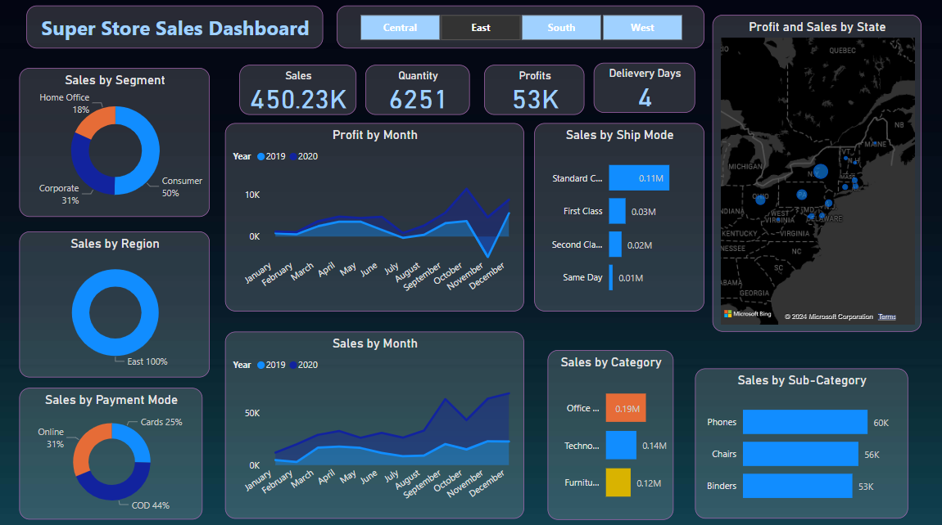

Slide 7
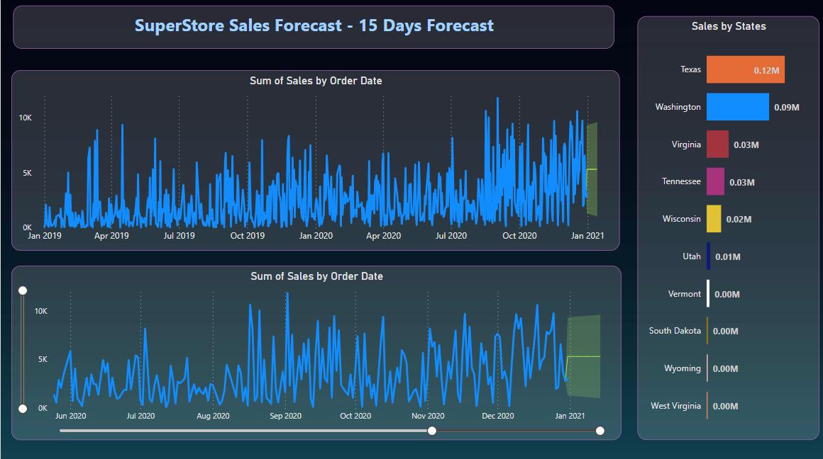

Slide 8

LEARNING
Incorporate Data analysis Techniques, specializing in time series analysis, accurate sales forecasting, and interactive dashboard creatio, driving business success.
This Photo by Unknown author is licensed under CC BY-SA-NC.

Slide 9


This Photo by Unknown author is licensed under CC BY-NC.

